Slide 1
MassMutual DSDP 2017: Visualization Techniques
June 9, 2017
R. Jordan Crouser & Amelia McNamara
Statistical & Data Sciences
Smith College

Slide 2
Housekeeping

Slide 3
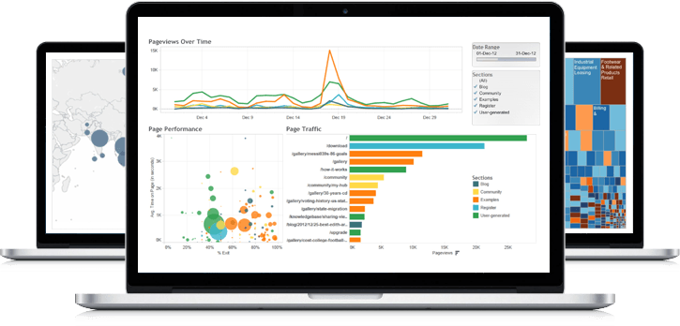
What visualization techniques do you know?

Slide 4
Bar chart
Used for comparable variables
Compares quantitative values for different categories
Highlights relative amounts
Grouped/stacked bars can break each category into sub-groups

Slide 5
Histogram
Looks like a bar chart… but the x-axis is continuous
Y-axis shows count or relative frequency
Highlights distribution
Note: bin size makes a big difference!

Slide 6
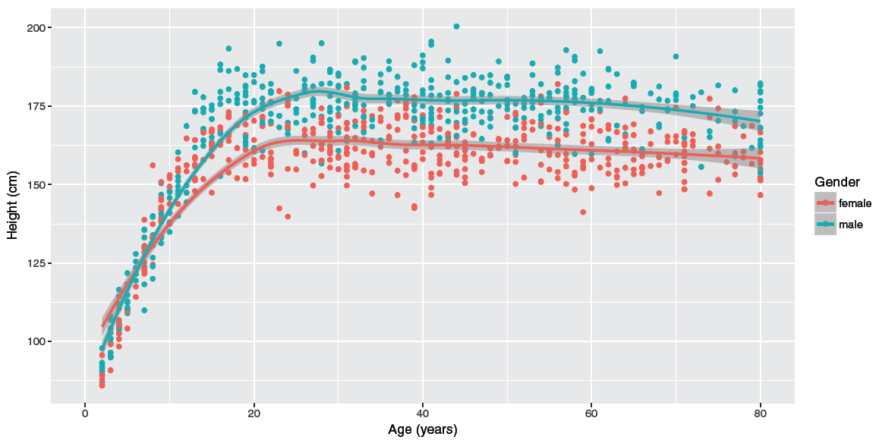
Scatterplot
Shows the relationship between two continuous variables
Each point in the plot represents an observation
You can change color or symbol to highlight groups
Sometimes useful to show a trend line (regression)
Sex

Slide 7
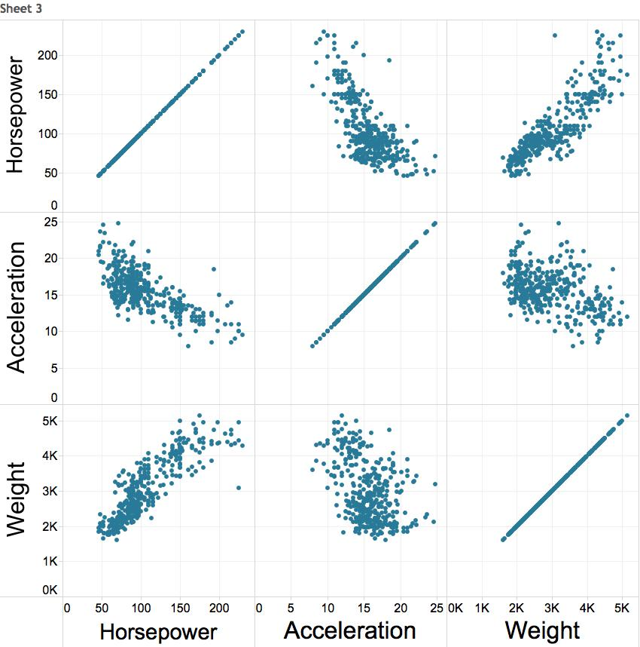
Scatterplot matrix (SPLOM)
Scatterplots show the relationship between just two continuous variables at a time
We can combine multiple scatterplots into a matrix to show additional relationships

Slide 8
Line chart
Shows the trend in one variable, often over time
Multiple lines can show multiple variables, or the same variable for multiple observations (must have the same scale!)
Highlights “position switches”

Slide 9
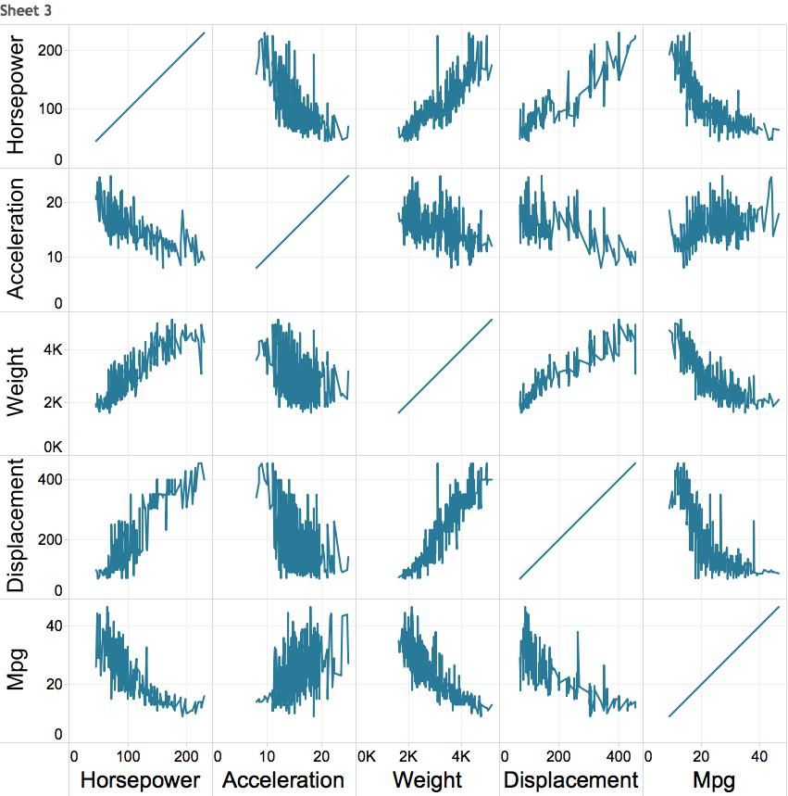
Multiple variables: line chart matrix?

Slide 10
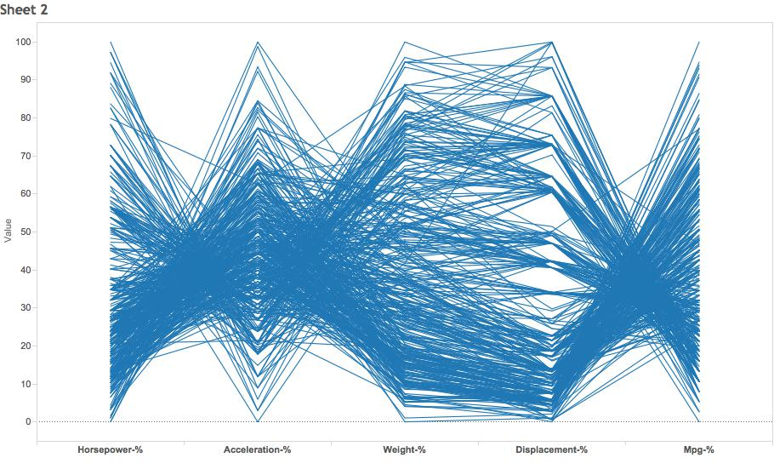
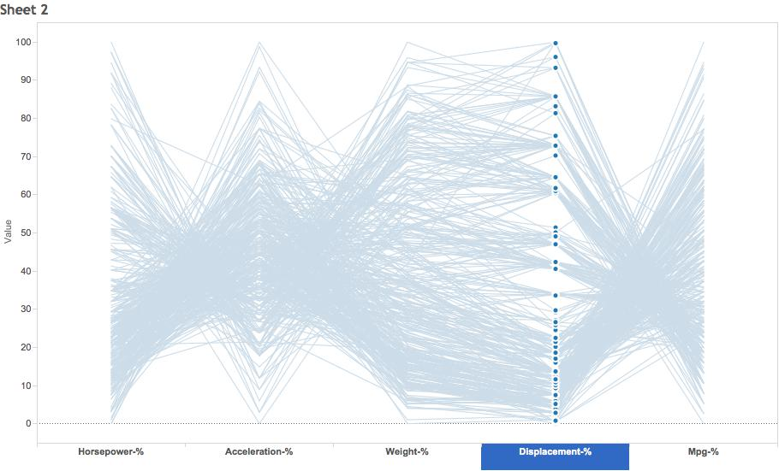
Weirder idea
H A W D M
“parallel coordinates plot”

Slide 11
Morning Challenge
H A W D M
“parallel coordinates plot”
How would you build this using ggplot2?

